Slide 1


Capstone Project Computer Vision
Mercedes AMG Petronas Formula One Team
Team Principle & CEO
Toto Wolff
Managing Director
Andy Cowell
Technical Director
James Allison
Driver 1
Lewis Hamilton
Driver 2
Valtteri Bottas
3 December 2020
Presenter: Ricky K Nguyen

Slide 2
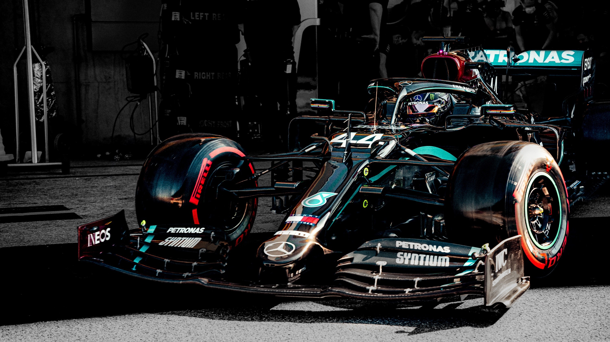
Business Context
Project Pipeline
Data Science Process
Recommendation
Future Application

Slide 3
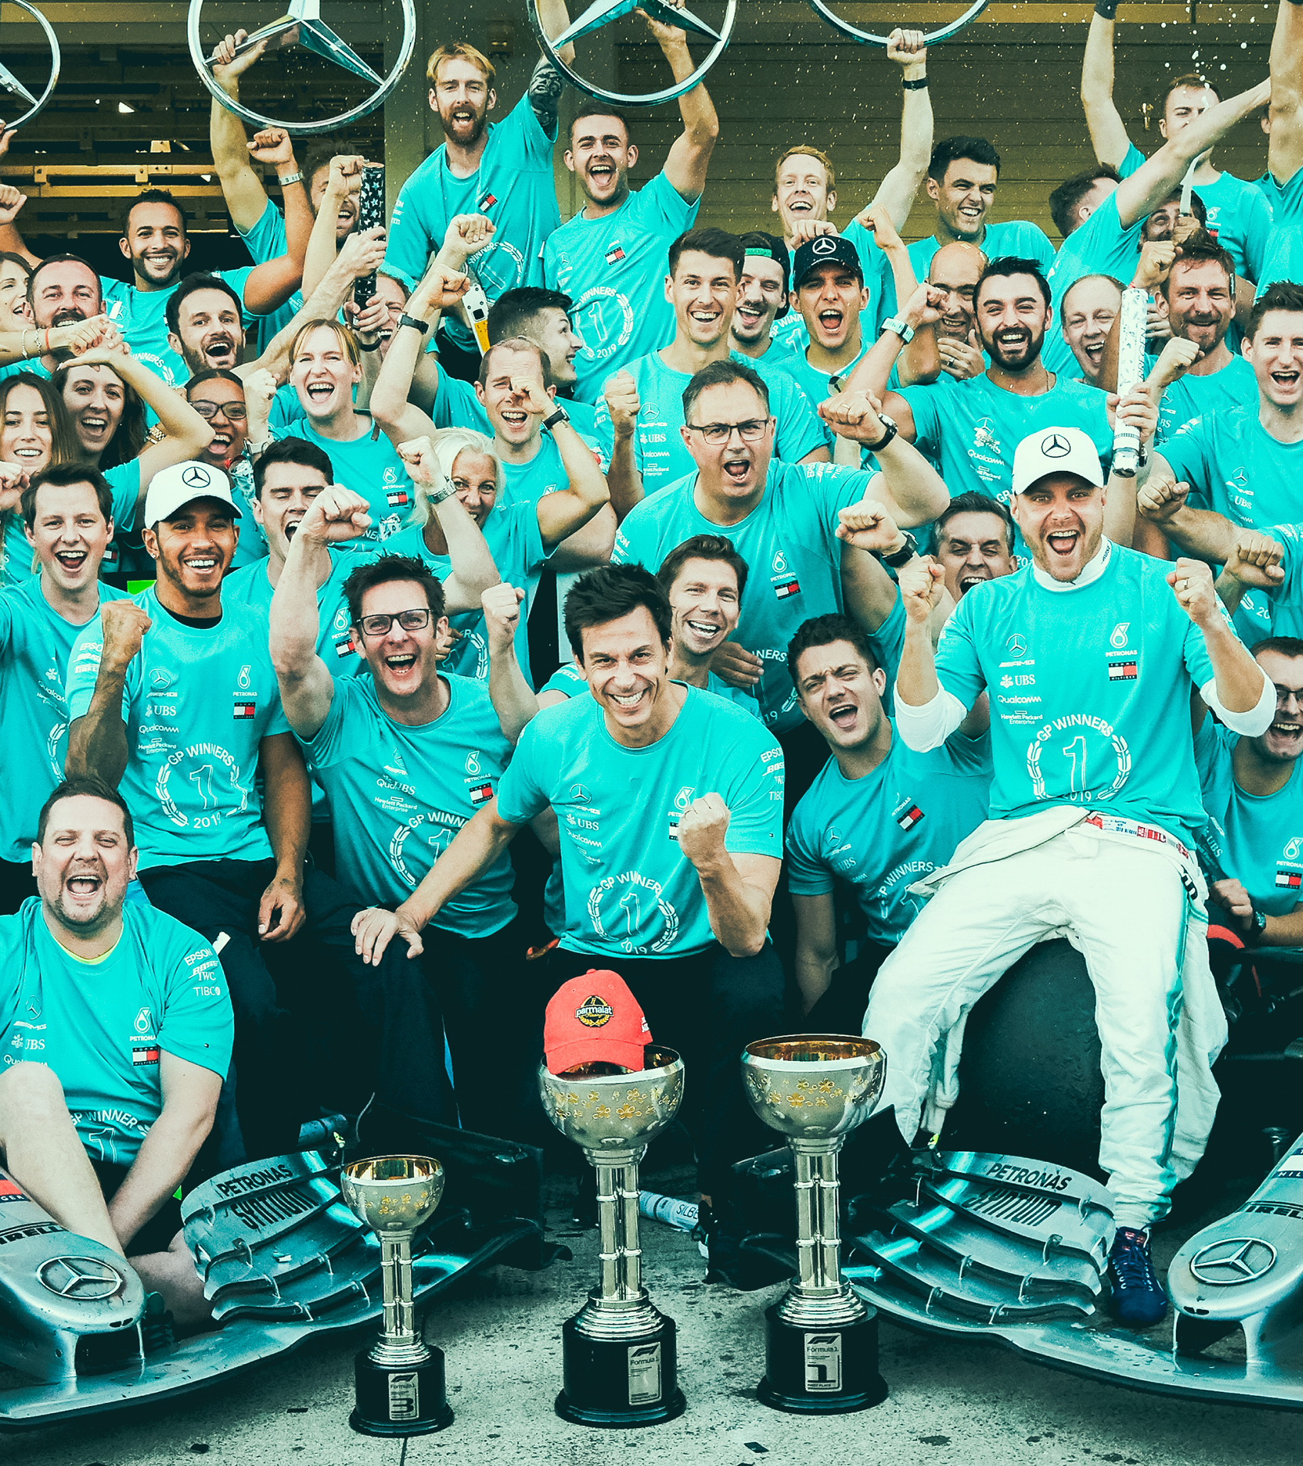

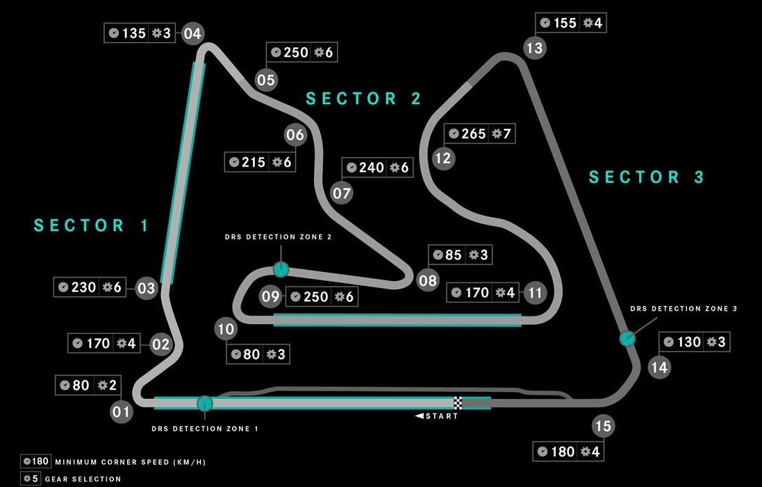







Formula One
Bahrain Track – 57 Laps
F1 is the most popular Motorsport in the World with total revenue at $2 billion USD in 2019
Mercedes spend $400 million and employed 1000 staff
Fuel & Tyres are key factor to win
Driver decide to Speed or Conserve
Engineers monitored car’s performance and durability
Engineers inform driver of the rival status

Slide 4
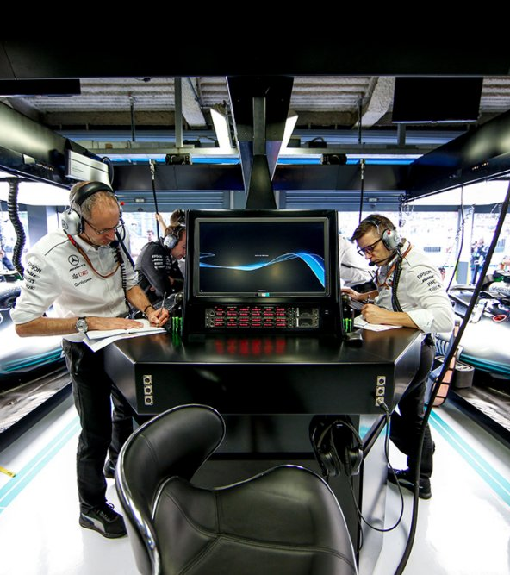
Business Question
How can we reduce the miscommunication between engineer and driver, thus improve the decision-making of the driver?
Data Question
How can we use artificial intelligence to identify driver on the track?

